Slide 1
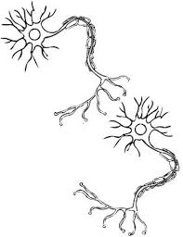
Machine Learning On The SpiNNaker Platform For The Visual Input Processing Of A Ball Catching Robot
Speaker: Hanyi Hu
Supervisor: Dr Konstantin Nikolic & Dr Benjamin Evans
Date: 22nd of June, 2016

Slide 2
Ball Catching Robot
Challenges
Environment
Humanoid Interaction
Hardware Usage
Notes:
State the purpose of project: ball catching robot
Challenges: factors in the environment, different objects
The reason of doing machine learning

Slide 3

Overview
Ball Catching Model
System Overview
Neural Network Models
Tests
Future Work
Notes:
State the purpose of project: ball catching robot
Challenges: factors in the environment, different objects
The reason of doing machine learning

Slide 4
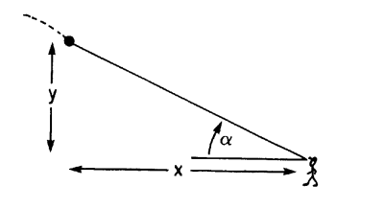
Ball Catching Models
Human Ball Catching Model
Angle of Elevation (α)

Slide 5
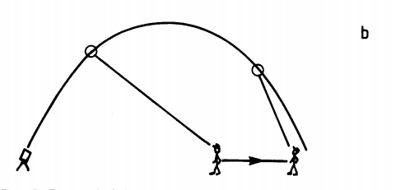


Ball Catching Models
Human Ball Catching Model
Constant Changing Rate of Acceleration of tan(α)

Slide 6
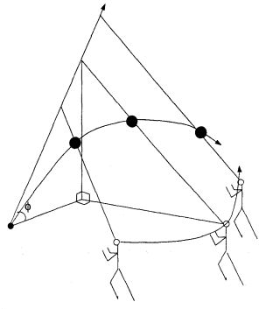
Ball Catching Models
Human Ball Catching Model
A Straight Line in Field of View

Slide 7
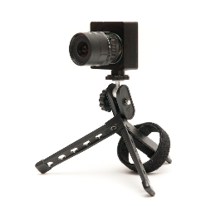
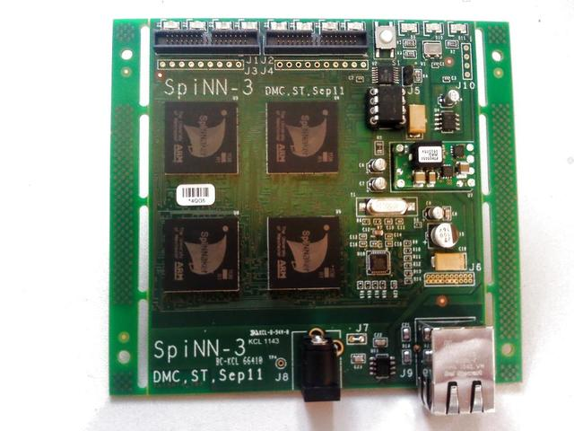

System Overview
System Block Diagram
DVS128 Camera
SpiNNaker Platform
Eye
Brain
Block Diagram of Simulation Configuration

Slide 8

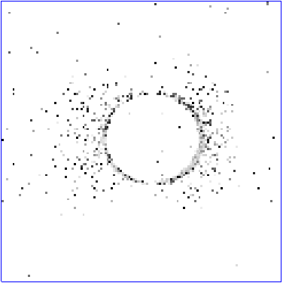
System Overview
DVS128
Ball Trajectory Emulation on MATLAB & jAER Recording

Slide 9
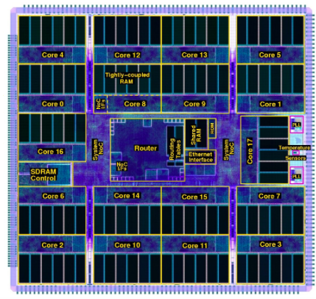
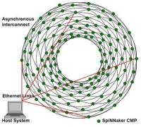
System Overview
SpiNNaker Platform
SpiNNaker Chip Structure & Virtual Artificial Neuron Synthesis

Slide 10
Neuron Network Models
Artificial Neural Network
Model
Leaky Integrate & Fire Neuron Model
Lateral Inhibition
Spiking-Timing Dependent Plasticity Learning Rule

Slide 11
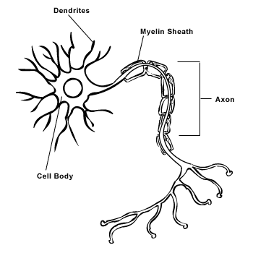
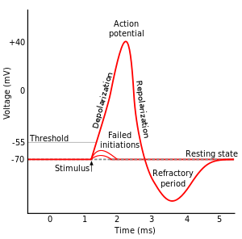
Neuron Network Models: Neuron Model
Neuron Characteristics
Dendrite
Axon
Soma
Neuron Structure
Neuron Action Potential

Slide 12
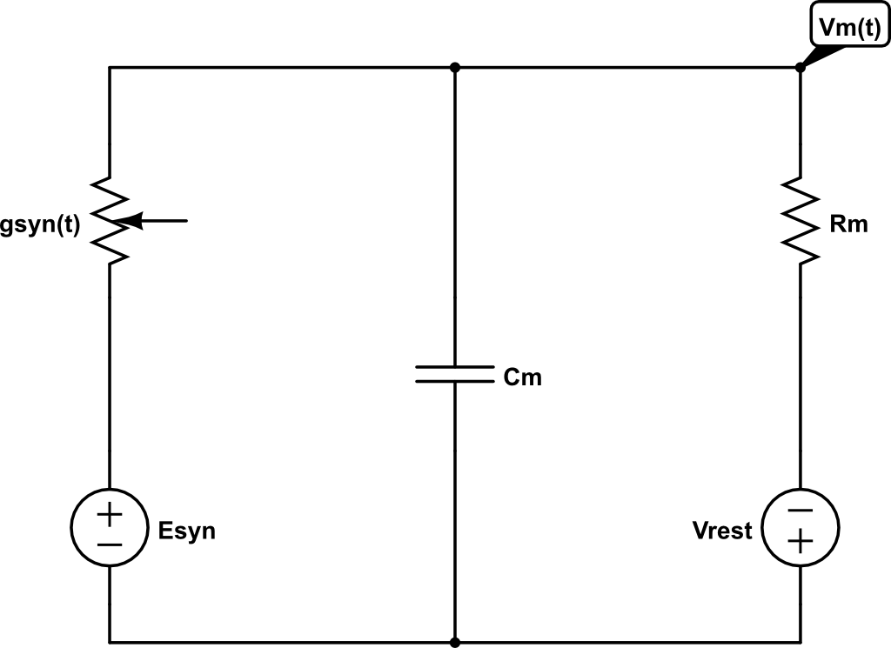

Neuron Network Models: Neuron Model
Leaky Integrate & Fire
Model (LIF)
Equivalent Cell Membrane Electrical Circuit
Notes:
𝐶_𝑚 (𝑑𝑉_𝑚 (𝑡))/𝑑𝑡 +𝑔_𝑠𝑦𝑛 (𝑡)(𝑉_𝑚 (𝑡)−𝐸_𝑠𝑦𝑛 )+ (𝑉_𝑚 (𝑡)−𝑉_𝑟𝑒𝑠𝑡)/𝑅_𝑚 = 0

Slide 13
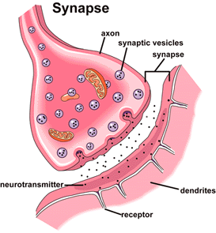
Neuron Network Models: Neuron Model
Synapse Characteristics
Neuron Connectivity
Synapse Cleft Structure

Slide 14
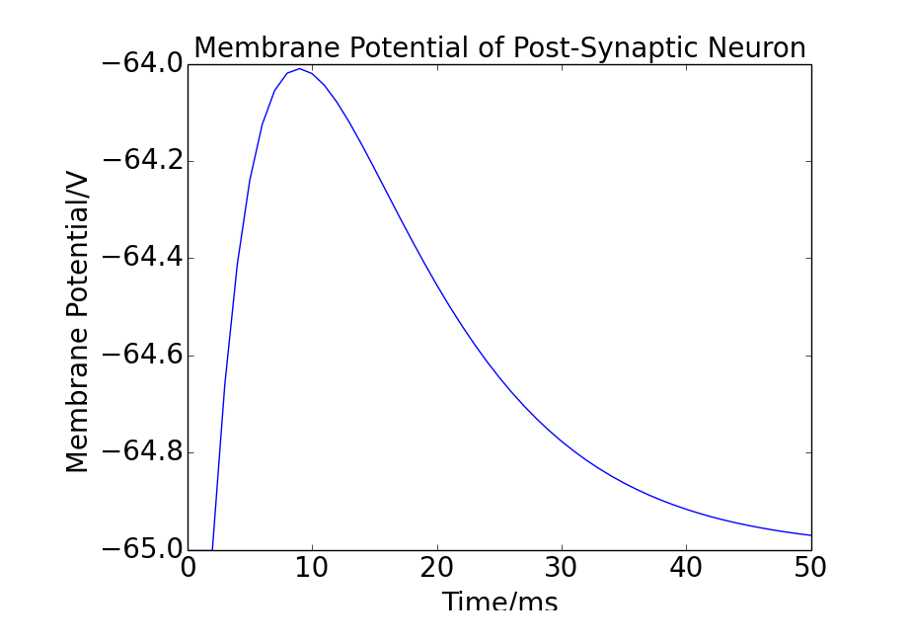




Neuron Network Models: Neuron Model
LIF Parameters
Simulation of Excitatory Synaptic Stimulation
Notes:
𝐶_𝑚 (𝑑𝑉_𝑚 (𝑡))/𝑑𝑡 +𝑔_𝑠𝑦𝑛 (𝑡)(𝑉_𝑚 (𝑡)−𝐸_𝑠𝑦𝑛 )+ (𝑉_𝑚 (𝑡)−𝑉_𝑟𝑒𝑠𝑡)/𝑅_𝑚 = 0

Slide 15
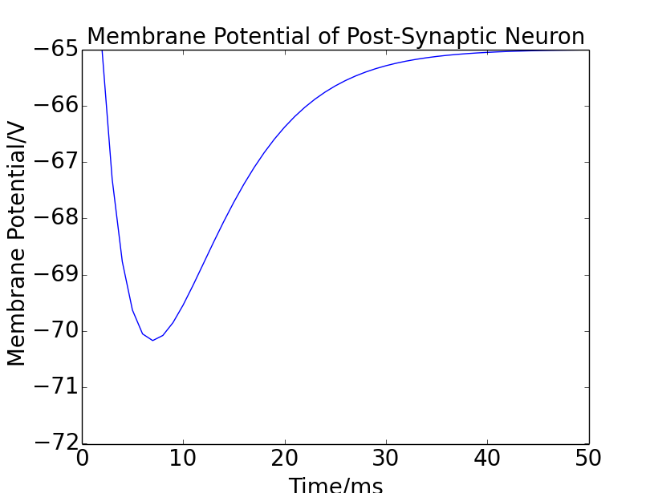

Neuron Network Models: Neuron Model
LIF Parameters
Simulation of Inhibitory Synaptic Stimulation
Notes:
𝐶_𝑚 (𝑑𝑉_𝑚 (𝑡))/𝑑𝑡 +𝑔_𝑠𝑦𝑛 (𝑡)(𝑉_𝑚 (𝑡)−𝐸_𝑠𝑦𝑛 )+ (𝑉_𝑚 (𝑡)−𝑉_𝑟𝑒𝑠𝑡)/𝑅_𝑚 = 0

Slide 16
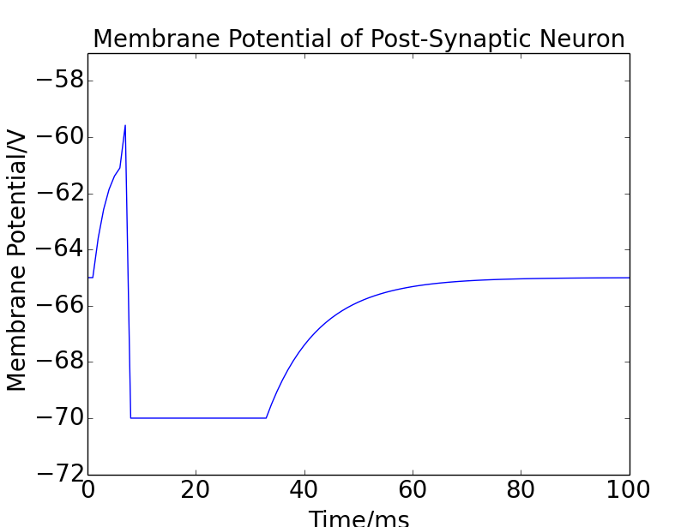





Neuron Network Models: Neuron Model
LIF Parameters
Simulation of A Single Post-Synaptic Neuron
Notes:
𝐶_𝑚 (𝑑𝑉_𝑚 (𝑡))/𝑑𝑡 +𝑔_𝑠𝑦𝑛 (𝑡)(𝑉_𝑚 (𝑡)−𝐸_𝑠𝑦𝑛 )+ (𝑉_𝑚 (𝑡)−𝑉_𝑟𝑒𝑠𝑡)/𝑅_𝑚 = 0

Slide 17
Neuron Network Models: Learning Rule
Spiking-Timing Dependent
Plasticity (STDP)
Timing Dependent Rule
Weight Dependent Rule

Slide 18
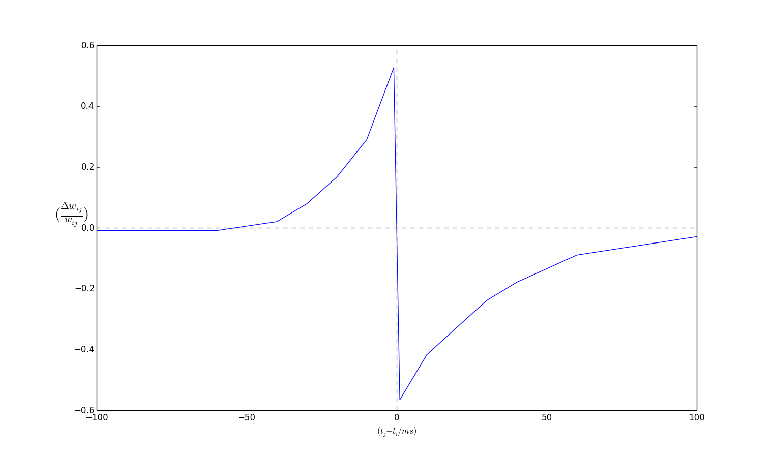


Neuron Network Models: Learning Rule
Spiking-Timing Dependent
Plasticity (STDP)
Timing Dependent Rule

Slide 19
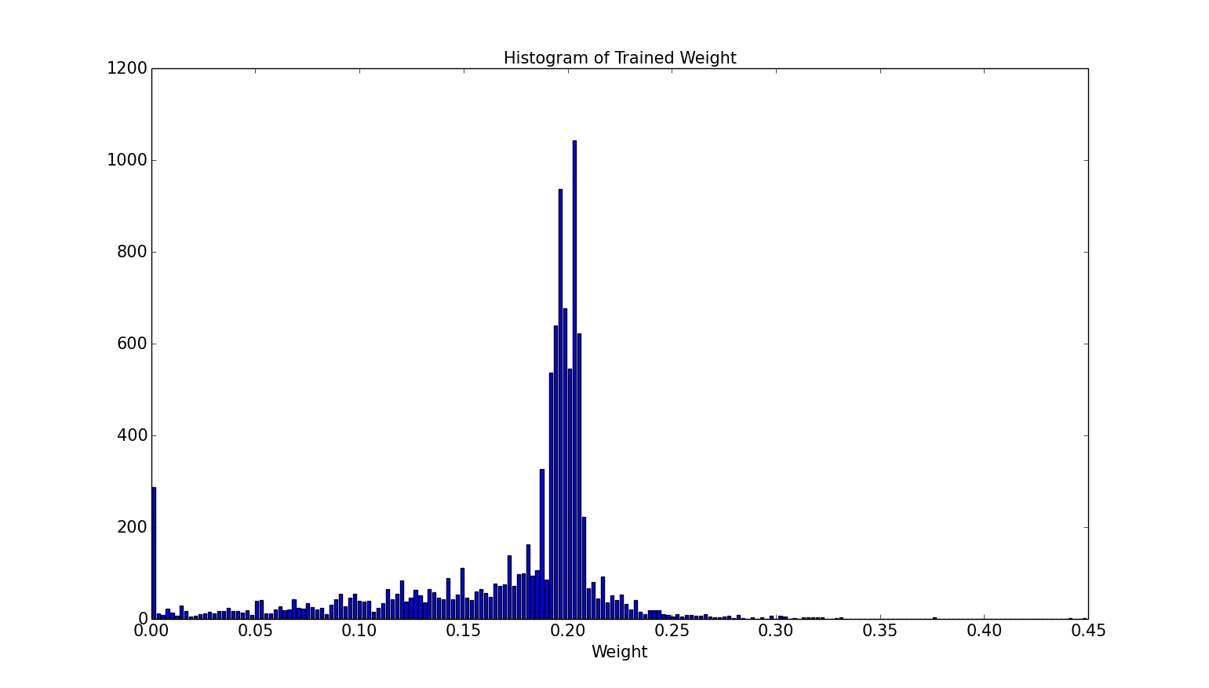
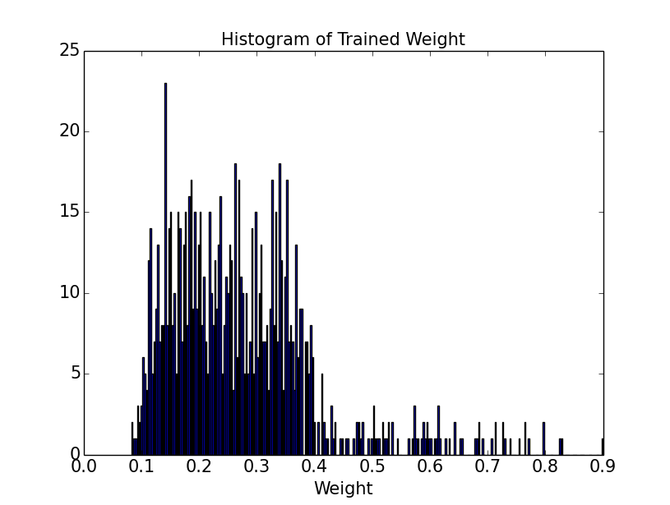
Neuron Network Models: Learning Rule
Spiking-Timing Dependent
Plasticity (STDP)
Weight Dependent Rule
Notes:
Replace the additive histogram

Slide 20
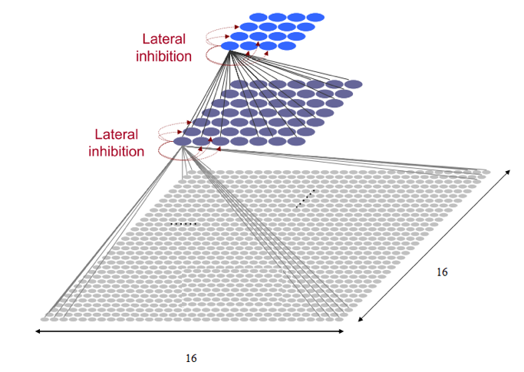
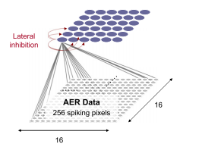
Neuron Network Models: Network Topology
Neural Network Topology
Output Layer
4 Neuron
Output Layer
4 Neuron
Intermediate Layer
45 Neuron
Input Layer
256 Neuron
Input Layer
256 Neuron
Three Layer Topology
Two Layer Topology

Slide 21
Neuron Network Models
Training Method & Configuration
Parameter Name | Parameter Value
Number of Input Trajectory Spikes | 88
Number of Trajectory Direction | 4
Number of Noise Spikes | 11
Trajectory Period | 200ms
Silent Period Between Trajectory Period | 200ms
Training Method | Converge Sequentially
Single Neuron Training Period | 32s
Number of Trajectory In Each Direction | 9
Weight Initialisation Function | Uniform Distribution

Slide 22
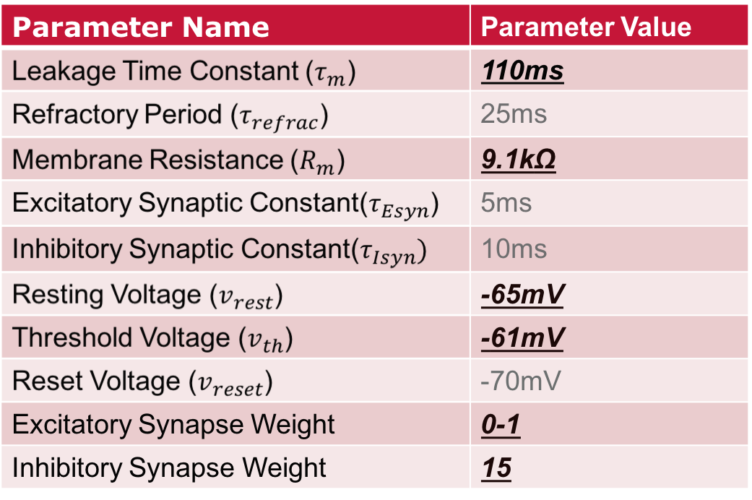
Neuron Network Models
Two Layer LIF Parameter List

Slide 23
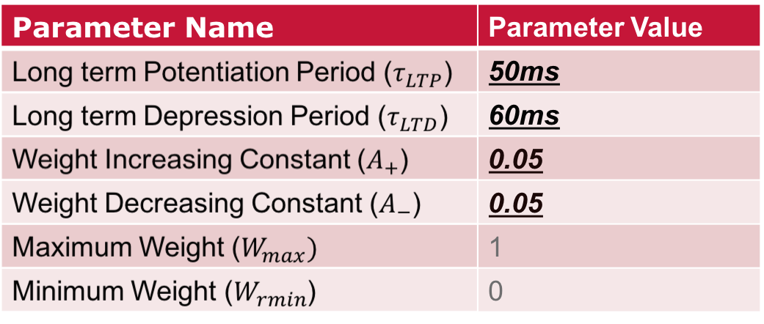
Neuron Network Models
Two Layer STDP Parameter List

Slide 24
Neuron Network Models: Parameter Settings
Key Criteria of Parameter Settings
1.Enough Pre-synaptic Neuron Spikes Contributing To
Post-Synaptic Neuron Spikes
2. Same Number of Spikes For Each Pattern (Learning
Outcome Depends On Background Spiking Level)
3. One Output Neuron Sensitive to One Pattern

Slide 25
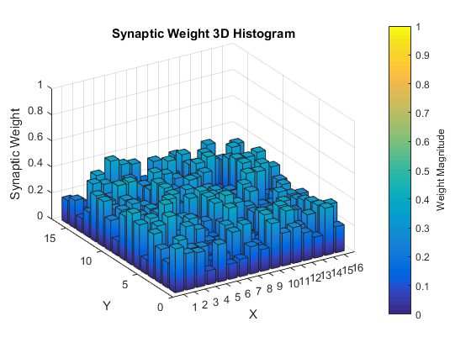
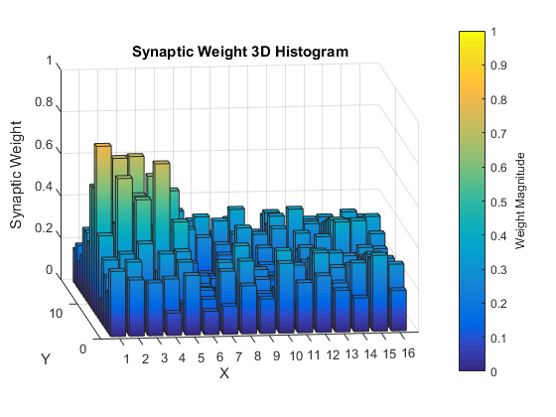
Neuron Network Models
Synapse Evolution During
Training Period
Initialised Synapse Weight
Trained Output Synapse Weight
(Left to Right)

Slide 26
Neuron Network Models
Post-Synaptic Neuron Learning
Result
Neuron Index | Trained Direction
0 | Upwards
1 | Left
2 | Downwards
3 | Right

Slide 27
Neural Network Testing
After Training Tests
Direction Validation Test
Performance Tests For Pattern not used in training
1.Angle Variation Test
4.Ball Size Test
2.Trajectory Shifting Test
5.Noise Level Test
3.Speed Test

Slide 28

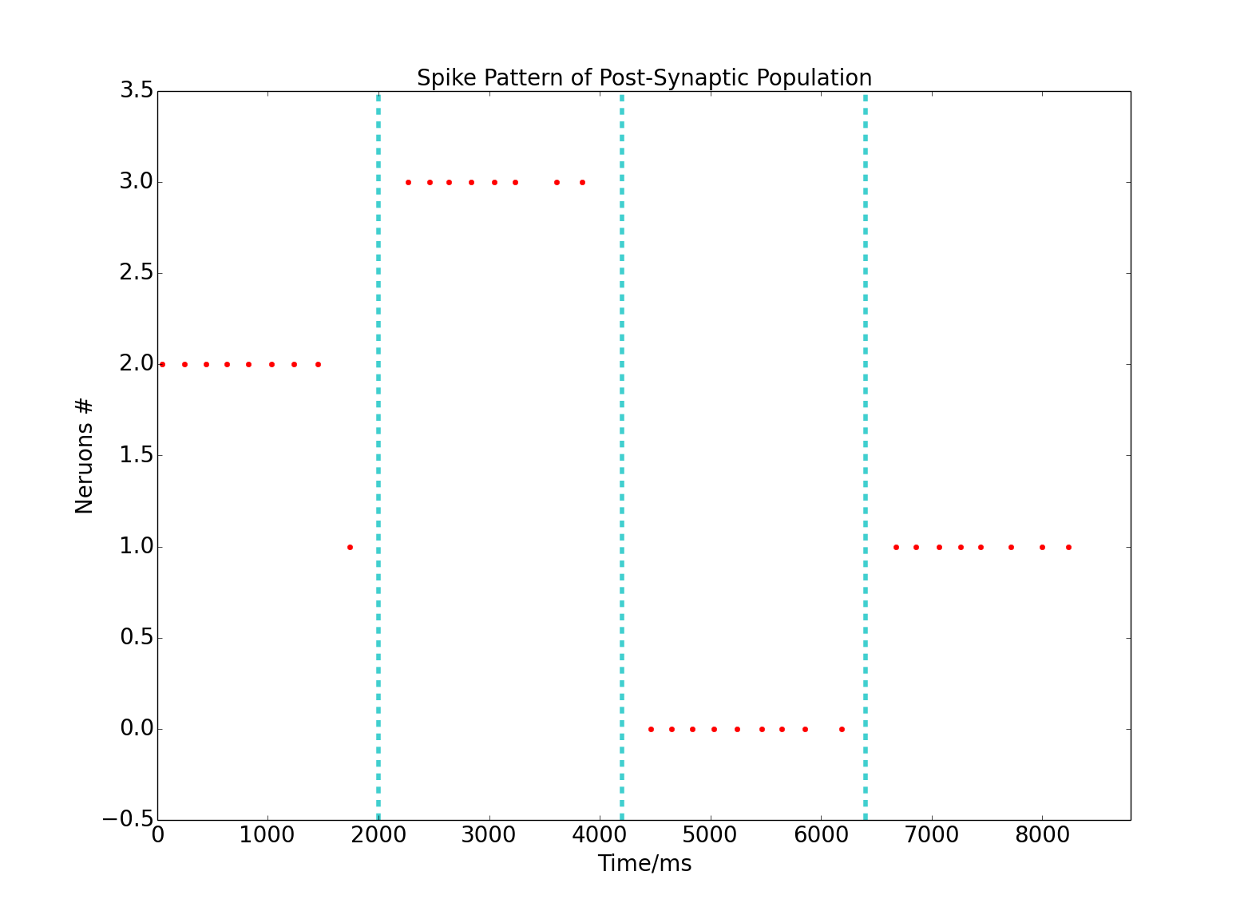
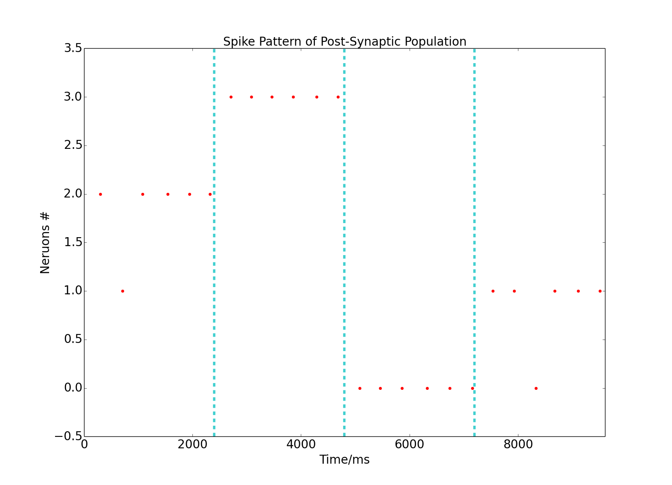
Neural Network Testing: Direction Validation Tests
Post-Synaptic Neuron Spiking Pattern After Training
Training Data Sets
Testing Data Sets

Slide 29

Neural Network Testing: Performance Tests
Angle Variation Test
Same Starting Position
Crossing Centre of FOV

Slide 30
Neural Network Testing: Performance Tests
Angle Variation Test
Same Starting Position
Crossing Centre of FOV
 | Lower Boundary | Upper Boundary
Left | -30° | 30°
Upwards | 40° | 140°
Right | 150° | 210°
Downwards | 220° | 300°
Very Insensitive…...
70° of Variation Can Be
Classified As Same Direction

Slide 31
Neural Network Testing: Performance Tests
Trajectory Shifting Test
Tolerate At Least Half Radius
Shifting For Each Direction

Slide 32
Neural Network Testing: Performance Tests
Speed Test
Number of Spikes
Period of Trajectory
Test Range:
44 - 132
Test Range:
100ms – 250ms
Detectable Range:
77 - 132
The Shorter, The Better

Slide 33
Neural Network Testing: Performance Tests
Ball Size Test
Tolerate Better For Smaller Size
Ball Than Large Size

Slide 34
Neural Network Testing: Performance Tests
Noise Level Test
Tolerate Up to 50%
Random Noise Spikes
In 200ms

Slide 35
Future Work
1. Record & Training More Trajectories
2. Increase Threshold Voltage & Weaken
Trained Output Synapse Weight
3. Implement System In Real Time

Slide 36
Reference
[1] SpiNNaker home page. University of Manchester. Available at: http://www. apt.cs.man.ac.uk/projects/SpiNNaker/
[2] H. S. Leow1, and K. Nikolic,”Machine Vision Using Combined Frame-based and Event-based Vision Sensor,” in 2015 IEEE International Symposium on Circuits and Systems (ISCAS), Lisbon, 2015
[3] Z.Gu, I.Yamamoto, el al. ”Development of forceps robot for surgical operation by biomechanism application,” In 2011 4th International Conference on Biomedical Engineering and Informatics (BMEI), 2011
[4] J.Saleh, F.Karray, et al ”A Qualitative Evaluation Criterion for Human-Robot Interaction System in Achieving Collective Tasks,” in Fuzzy Systems (FUZZ-IEEE), 2012 IEEE International Conference, 2012
[5] M.Chemnitz,G.Schreck, et al ”Analyzing energy consumption of industrial robots,” in Emerging Technologies & Factory Automation (ETFA), 2011 IEEE 16th Conference, 2011
[6] S. Furber, and A.Brown, ”Biologically-Inspired Massively-Parallel Architectures - Computing Beyond a Million Processors,” In Application of Concurrency to System Design, ACSD ’09. Ninth International Conference, 2009
[7] B. Liu, M.Hu, et al, ”Bio-Inspired Ultra Lower-Power Neuromorphic Computing Engine for Embedded Systems,” in Hardware/Software Codesign and System Synthesis (CODES+ISSS), 2013 International Conference, 2013
[8] Y.Asano, K. Baba, et al. ”A prediction method considering object motion for humanoid robot with visual sensor,” In 2014 IEEE 13th International Workshop on Advanced Motion Control (AMC),2014
[9] K.Hashimoto, R.Mori, et al. ”Tracking and catching of 3d flying target based on gag strateg,” In:Robotics and Automation, 2004. Proceedings. ICRA ’04. 2004 IEEE International Conference, 2004
[10] O. Birbach, U. Frese, et al. ”Realtime Perception for Catching a Flying Ball with a Mobile Humanoid,” in IEEE International Conference on Robotics and Automation Shanghai International Conference Center, May 9-13, 2011, Shanghai, China, 2011
[11] F. Takagi, H. Sakahara, et al. ”Navigation Control for Tracking and Catching a Moving Target,” in The 2009 IEEE/RSJ International Conference on Intelligent Robots and Systems October 11-15, 2009 St. Louis, USA, 2009
58
[12] S. Chapmen, ”Catching a baseball,” American Journal of Physics. vol. 36, no.10, pp. 868-870,1968
[13] P.McLeod, and N.Reed, et al. ”Do Fielders Know Where to Go to Catch the Ball or Only How to Get There? ”Journal of Experimental Psychology:Human Perception and Performance. VoL 22, No. 3, 531-543, 1996
[14] M. McBeath and D. Shaffer, et al. ”How baseball outfielders determine where to run to catch fly balls,” Science (New York, N.Y.). vol.268, no. 5210, pp.569-573, 1995
[15] M. Gillies and N.Dodgson, ”Ball catching: An example of physiologically-based behavioural animation,” Eurographics UK, 1999
[16] C. Koch ”The Synaptic Input” in Biophysics of Computation: Information Processing in Single neuron Oxford, UK: Oxford University Press, Inc., pp85-112, 1999
[17] C. Koch ”The Membrane Equation” in Biophysics of Computation: Information Processing in Single neuron Oxford, UK: Oxford University Press, Inc., pp5-14, 1999
[18] C. Koch ”Synaptic Plasticity” in Biophysics of Computation: Information Processing in Single neuron Oxford, UK: Oxford University Press, Inc., pp308-329, 1999
[19] O. Bichler, D. Querlioz, et al. ”Unsupervised features extraction from asynchronous silicon retina through Spike-Timing-Dependent Plasticity,” in: Neural Networks (IJCNN), The 2011 International Joint Conference on, 2011
[20] F. Gallupi, and S. Furber, ”Representing and decoding rank order codes using polychronization in a network of spiking neuron” in Neural Networks (IJCNN), The 2011 International Joint Conference, 2011.
[21] E. M. Izhikevich. ”Polychronization: Computation with Spikes,” in Neural Computation (Volume:18 , Issue: 2 ), pp 245 - 282, 2006.
[22] Dynamic Vision Sensor Overview. iniLabs. Available at: http://inilabs.com/products/dynamic-vision-sensors/
[23] User Guide: DVS128 page. iniLabs. Available at: http://inilabs.com/support/hardware/dvs128/
[24] File format (AEDAT). AEDAT formats. iniLabs. Available at: http://inilabs.com/support/software/fileformat/
[25] D. Magliocchetti-Lombi, ”Comparison of machine learning algorithms for use on the spinnaker platform,” Final Year Project Thesis, Imperial College London, 2015
[26] SpiNNaker Project - The SpiNNaker Chip. APT Advanced Processor Technologies Research Group. Available at: http://apt.cs.manchester.ac.uk/projects/SpiNNaker/SpiNNchip/
59
[27] Biologically-Inspired Massively Parallel Computation (BIMPC) Home Page. APT Advanced Processor Technologies Research Group. Available at: http://apt.cs.manchester.ac.uk/projects/BIMPC/
[28] SpiNNaker Project - Boards and Machines. APT Advanced Processor Technologies Research Group. Available at: http://apt.cs.manchester.ac.uk/projects/SpiNNaker/hardware/
[29] W. Li, ”Machine Learning Tasks on SpiNNaker Platform,” Final Year Project Thesis, Imperial College London, 2015

Slide 37
Question
Thank You Very Much For Listening
Questions?

